Slide 1
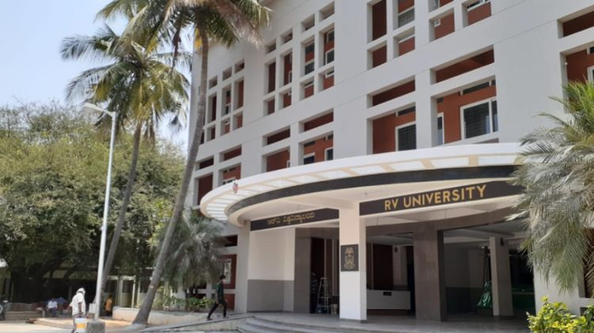


Weather-Based Song Recommendation System
Using ESP32 and Machine Learning Integration with Spotify
RV UNIVERSITY, BENGALURU-59 | 2025-2026

Slide 2







Meet the Team
Under the Guidance of: Prof. SHILPA HIREMATH
ABHISHEK KS
ANIKET KUMAR
AYON ARYAN
1RVU23CSE017
1RVU23CSE055
1RVU23CSE093

Slide 3

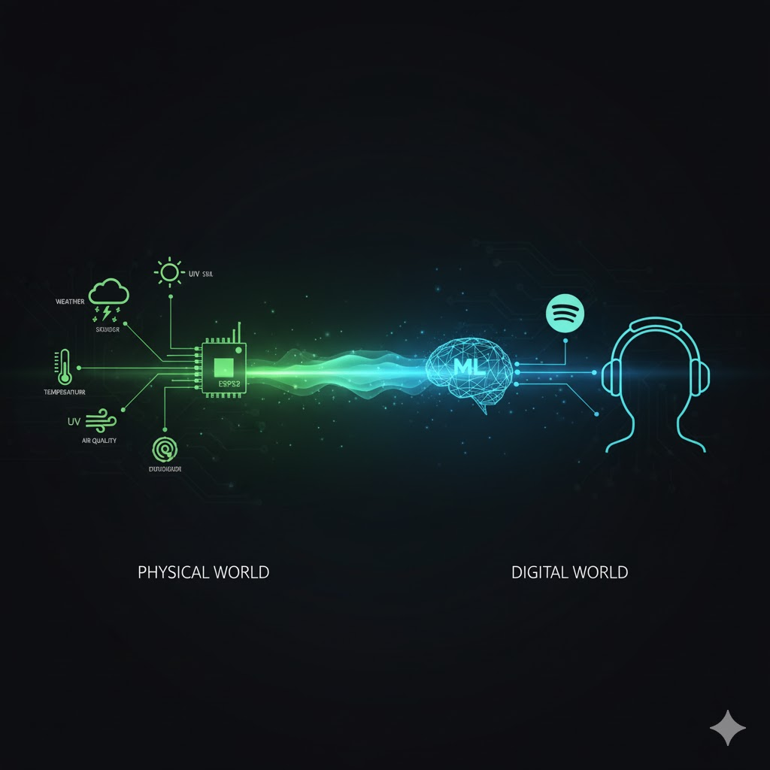
Introduction: IoT, AI, and Experience
Bridging Physical and Digital Worlds
This project introduces a novel, context-aware system that uses environmental sensing and machine learning to enhance user experience.
An ESP32 microcontroller and a suite of sensors collect real-time environmental data.
A trained Machine Learning model that recommends song based classified weather, which then automatically triggers a song recommendation via the Spotify API.
It's a practical application of mood-aware automation for smart homes and digital entertainment.

Slide 4




Problem & Solution Flow
The Problem: Lack of Context
Our Solution: Contextual Automation
Traditional music systems lack real-time, contextual awareness, relying only on past user history.
Real-Time Sensing
ESP32 gathers hyper-local Temp, Hum, Rain, UV data.
Standard weather tools are costly and fail to provide the hyper-local data needed for personalized experiences.
ML Classification
KNN model accurately predicts one of 8 weather conditions.
We need a low-cost, automated system connecting environment to emotion.
Automated Playback
Spotify API uses OAuth to trigger mood-matched music instantly.

Slide 5
Project Objectives
IoT System Design: Implement ESP32 with multiple sensors (DHT11, BMP180, etc.) for real-time data collection.
ML Classification: Develop and train a KNN model to accurately categorize 8 distinct weather conditions.
API Integration: Seamlessly connect the classified weather output to the Spotify Web API for automated song playback.
Full Automation: Ensure the entire system operates end-to-end without any user intervention.
Performance Target: Achieve high accuracy and low latency, delivering a scalable, low-cost solution.

Slide 6

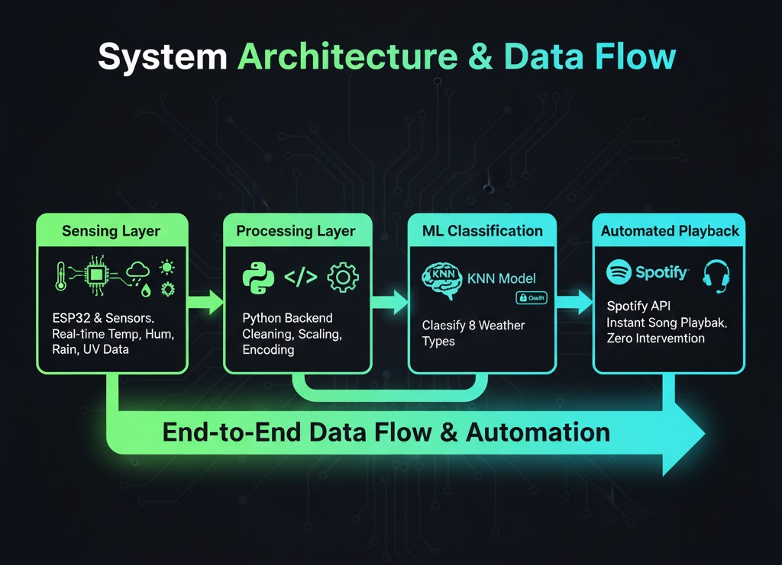

Methodology: System Architecture & Data Flow
Four Key Layers
1. Sensing Layer: ESP32 collects real-time data (Temp, Hum, Rain, UV) via multiple sensors.
2. Processing Layer: Python backend handles cleaning, scaling, and feature encoding.
3. ML Classification: KNN model instantly classifies data into 8 weather types.
4. Automated Playback: Zero Intervention
The Spotify Developer API (via Spotipy) uses OAuth to gain playback control. Once weather is classified, the system automatically and instantly pushes the matching song/playlist URI to the user's active device, requiring zero user intervention.

Slide 7

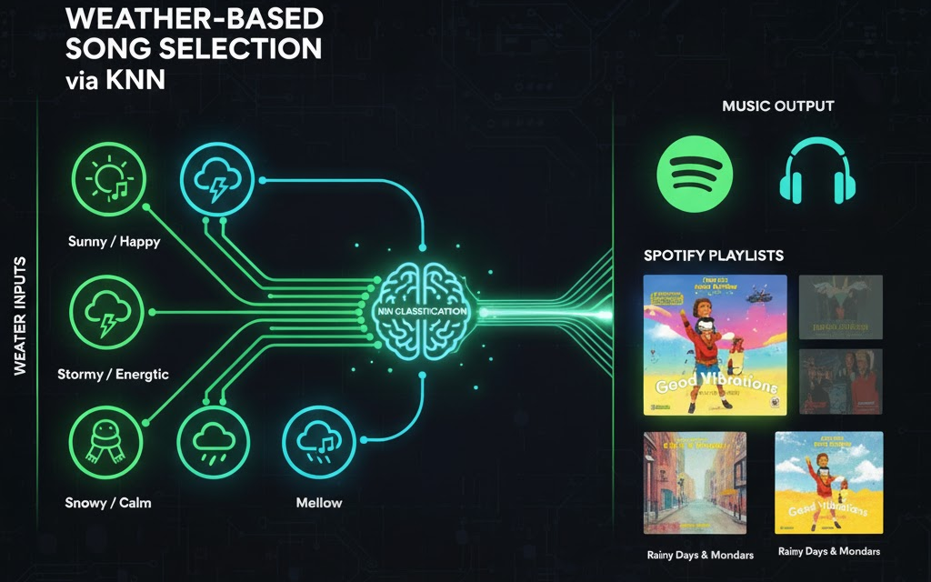

Methodology: KNN Classification
K-Nearest Neighbors (KNN)
Data & Clustering Visualization
KNN is used for its simplicity and effectiveness on our small, low-dimensional sensor dataset.
The model uses Euclidean Distance to find the nearest known weather examples for classification.
Euclidean Distance Formula

Slide 8
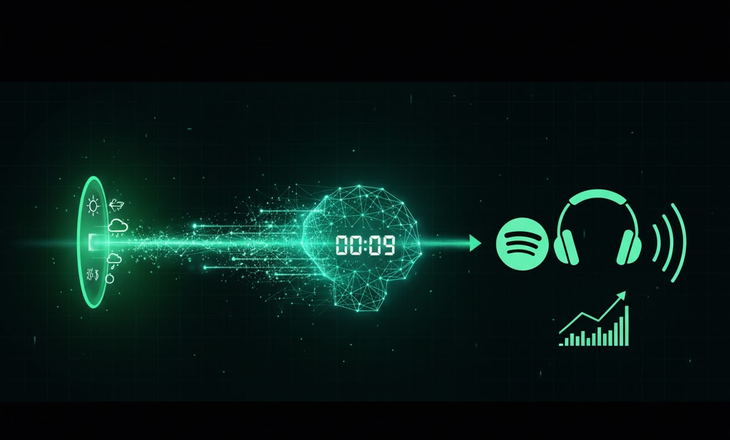

Results and Performance Summary
High-Speed Automation
Metric | Result / Finding
Model Accuracy (KNN) | 100%
Average Latency | < 10 seconds
System Reliability | Real-Time & Fully Automated
Classification Categories | 8 Types
The system ensures immediate context-based entertainment.

Slide 9




Key Innovations
Hyper-Local Sensing
End-to-End Automation
Context-Aware AI
Goes beyond generic city-wide forecasts to use immediate, personal environmental data from the user's exact location.
The Spotipy library and OAuth enable a seamless "sense-to-playback" loop. The system automatically controls the Spotify device, eliminating manual input.
Bridges the gap between the physical environment (weather) and an abstract emotional state (music preference).

Slide 10
Literature Review & Research Gap
Paper / Concept | Focus | Identified Research Gap
Context-Aware Music | Used user history & basic weather | Lacked live, real-time IoT integration for hyper-local data.
IoT Weather Monitoring | Focused purely on sensor data collection | Did not link the collected data to any user-centric applications.
Emotion-Based Music | Used emotion detection (CV/Audio) | Ignored the external environmental context (like weather) as a factor.
Our Project | Fills the Gap | Connects all three: Uses live IoT data (Context) to feed an ML model (AI) that triggers a personalized application (Music).

Slide 11
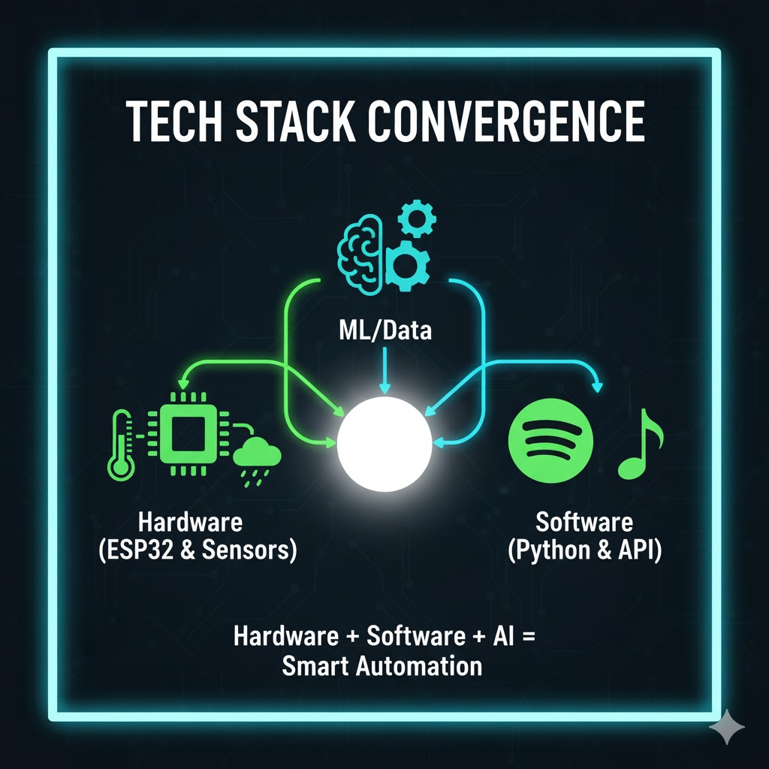

Tech Stack (Hardware & Software)
Hardware (ESP32 & Sensors)
Tech Stack Convergence
Microcontroller: ESP32
Temp/Hum: DHT11
Pressure/Alt: BMP180
Rain: Raindrop Sensor
Air Quality: MQ-135
Software (Python & API)
ML/Data: Scikit-learn, Pandas
API: Spotipy (Spotify Web API)

Slide 12
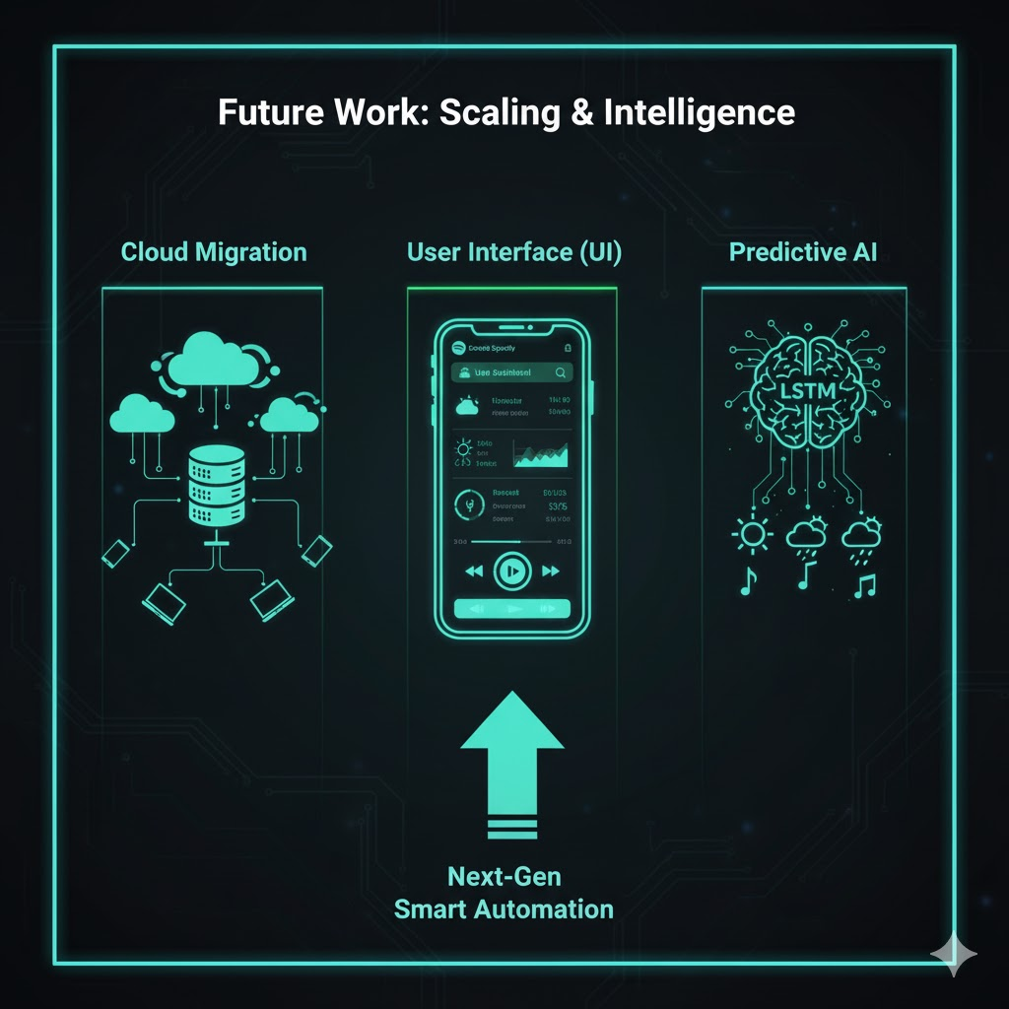
Conclusion & Future Work
Conclusion
The system successfully combines IoT, KNN classification, and Spotify integration, delivering a fully automated, context-aware music experience. It demonstrates high performance, achieving 100% accuracy in classification and a low latency (< 10 seconds) 'sense-to-playback' speed.
Future Work
Cloud Migration: Implement AWS/Azure backend for multi-user access and remote device support.
User Interface (UI): Develop a mobile/web application for data visualization and preference customization.
Predictive ML: Utilize Deep Learning models (e.g., LSTMs) for advanced weather prediction, moving beyond simple real-time classification.

Slide 13
Thank You
Questions?
References
[1]. “Spotify Web API Documentation,” Spotify for Developers, 2025. [Online]. Available: https://developer.spotify.com/documentation/web-api/
[2]. Pedregosa, F., Varoquaux, G., Gramfort, A., et al., “Scikit-learn: Machine Learning in Python,” Journal of Machine Learning Research, 2011.
[3]. D. Goldberg, “Music Recommendation Systems,” in Recommender Systems Handbook, 2nd ed., Springer, 2015.
[4]. Adafruit, “DHT11 Temperature & Humidity Sensor Datasheet,” 2025.

